Slide 1


GUIDE TO COMPLETING
THE TRAVEL CLAIM
DD FORM 1351-2
Updated January 2023

Slide 2
TRAVEL CLAIM EMAIL ADDRESS
  Travel claims must be submitted within 5 days after completion of travel
  Failure to submit a travel claim could result in:
    No future ADT orders
  ---Email travel claim to: usn.ncr.bumedfchva.mbx.usn-hpsp-adt-reimburse@health.mil

Slide 3
REQUIRED TRAVEL CLAIM
DOCUMENTS
  1. Endorsed Travel Orders and all issued Modifications
    ORDERS MUST BE STAMPED AT THE TIME YOU CHECK INTO YOUR ANNUAL TRAINING ASSIGNMENT AND WHEN YOU CHECK OUT OF YOUR ANNUAL TRAINING ASSIGNMENT. THIS IS CALLED “ENDORSEMENT.”
    NO ENDORSEMENT = NO REIMBURSEMENT.
  2. No Messing Available Letter – provided by the GME Office
    If your orders actually say, “The use of mess adversely affects mission performance, per diem authorized at commercial rate,” you do not need to submit this letter.
  3. Itemized Lodging Receipt – each day of lodging must be itemized. Provide your receipt showing zero balance as proof that lodging is paid in full.
  4. Only use Military lodging on base(Navy Lodge, Navy Gateway, Inns of the Corps). Book Early as these rooms fill up quickly.

Slide 4
REQUIRED TRAVEL CLAIM
DOCUMENTS (continued)
  5. If no on-base military lodging is available, request a Certificate of Non-Availability(CNA letter) before booking commercial lodging like Hilton or Marriott hotels. Book directly with the hotel don’t use Expedia, Orbitz or Airbnb to book off-base lodging.
  6. Car Rental –For official use only when authorized and provide the following:
    Car Rental Receipt
    Complete SATO Itinerary
    Gas Receipts - only for travel to and from lodging to clerkship facility. Gas not paid when POV is used only paid per authorized mile travelled. Not paid when used for personal trips in rental car.
    Paid in Full Toll Receipt-(Mostly in Portsmouth, VA location)
  7. Receipts – Taxi, shuttle, parking, transit, etc.
  8. Electronic Transfer of Funds (EFT) Form
  9. Temporary Duty Checklist

Slide 5
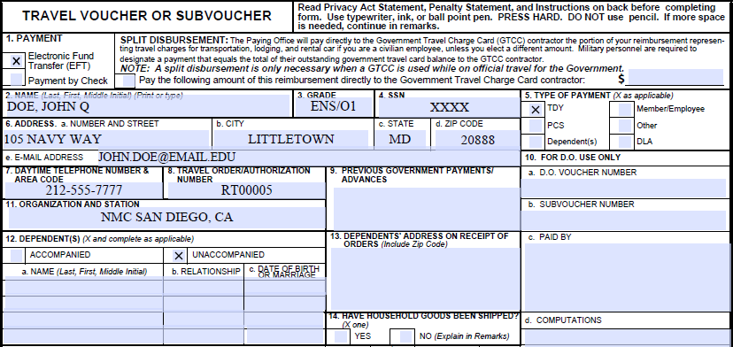
COMPLETING THE TRAVEL CLAIM
Block 1: This is how the payment will be made to the individual.
  Check Electronic Fund Transfer (EFT).

Slide 6
COMPLETING THE TRAVEL CLAIM, BLOCKS 2-4
Block 2: Enter Last Name, First Name, Middle Initial
Block 3: Enter Pay Grade
Block 4: Enter FULL Social Security Number

Slide 7
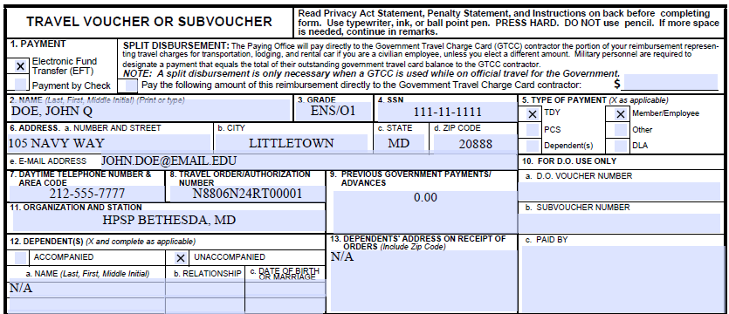
COMPLETING THE TRAVEL CLAIM, BLOCKS 5-9
Block 5: EVERYONE enters “TDY” regardless of the type of orders
Block 6: Enter your address and a valid email address
Block 7: Enter a daytime phone number
Block 8: Enter the SDN/travel order # found in the upper right-hand corner of the orders (Example-N8806N24RT00001)
Block 9: Leave blank if you did not take Advance Travel Pay. If you took Advance Travel Pay , put the amount of advance travel pay received.

Slide 8
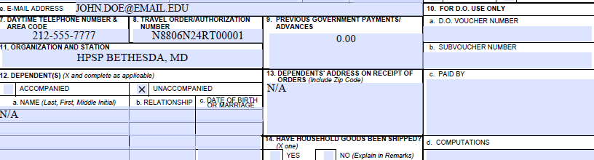
COMPLETING THE TRAVEL CLAIM,BLOCKS 10-14
Block 10: Leave Blank
Block 11: EVERYONE – Enter HPSP BETHESDA, MD
Block 12: Always mark “UNACCOMPANIED” Do not list dependents info in 12a, 12b, or 12c.
Blocks 13-14: Leave Blank

Slide 9
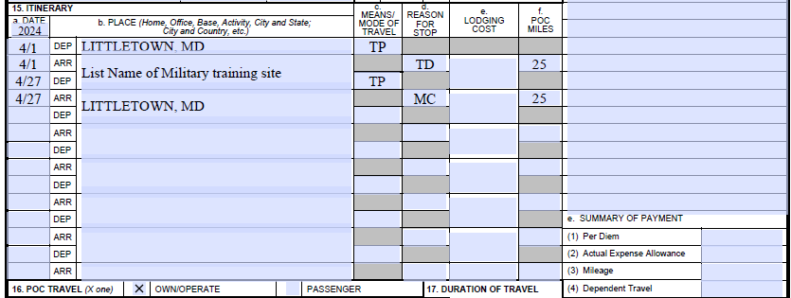
COMPLETING THE TRAVEL CLAIM, BLOCKS 15-16
List miles personally driven to/from airport if applicable and check bock 16.
        Block 15 Column A
        Your address of the City and state travel began and will end, and not the airport used.
  Under Date, enter the year (i.e., 2024)
You must enter a month and day for each Departure and Arrival (i.e., MM/DD, Example: 4/1)

Slide 10
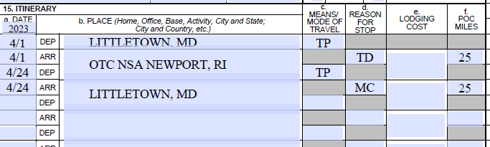
COMPLETING THE TRAVEL CLAIM:
Traveling by Commercial Air
Block 15 Column B
Traveling By Commercial Air:
Departing/Returning Home
  List the city and state that was departed from home address-Use TP for Transportation Provided
  List the training location name, city and state-List TD as reason for stop
  List the city and state You will arrive back to home address-List MC for mission complete as reason for stop

Slide 11
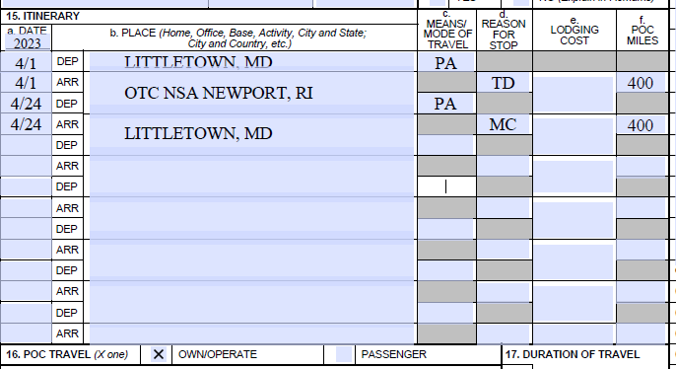
COMPLETING THE TRAVEL CLAIM:
Traveling by Privately Owned Car/Vehicle
Block 15 Column B
Travel with Personal Vehicle:
Departing/Returning Home
  List total miles to/from training
  List the city and state that was departed from home address-Use PA for personal vehicle.
  List the training location name, city and state-List TD as reason for stop
  List the city and state You will arrive back to home address-List MC for mission complete as reason for stop
  Check block 16

Slide 12
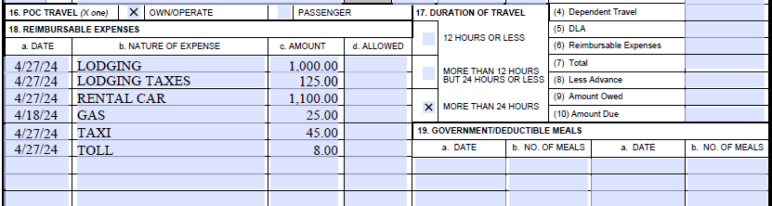
COMPLETING THE TRAVEL CLAIM BLOCK 18
Block 18: List expenses you want to be reimbursed for.
***Leave blank if not applicable to you***
  You must have a receipt for any expense over $75.00.
  Bank statement or credit card statements are not receipts
  Include all gas receipts directly related to travel to and from your lodging and medical facility (if you were authorized a rental car).
  Attach a copy of all taxi receipts, zero balance lodging receipt, rental car receipt, gas receipts, toll receipt, parking receipt if not on lodging receipt.

Slide 13
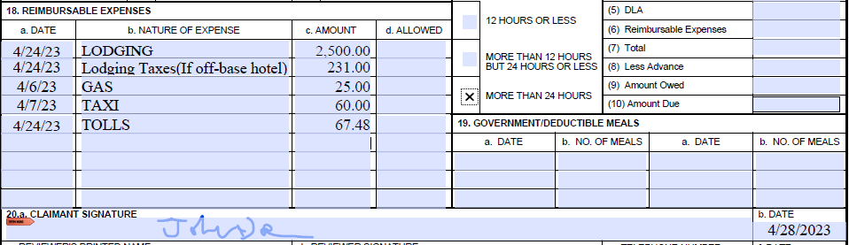
COMPLETING THE TRAVEL CLAIM BLOCK 20
Block 20: Sign and Date in block 20a. and block 20b.
CONGRATULATIONS, ALL DONE!

